Slide 1
13-2 STANDARD ETHERNET
The original Ethernet was created in 1976 at Xerox’s Palo Alto Research Center (PARC). Since then, it has gone through four generations. We briefly discuss the Standard (or traditional) Ethernet in this section.
Topics discussed in this section:
MAC Sublayer Physical Layer

Slide 2
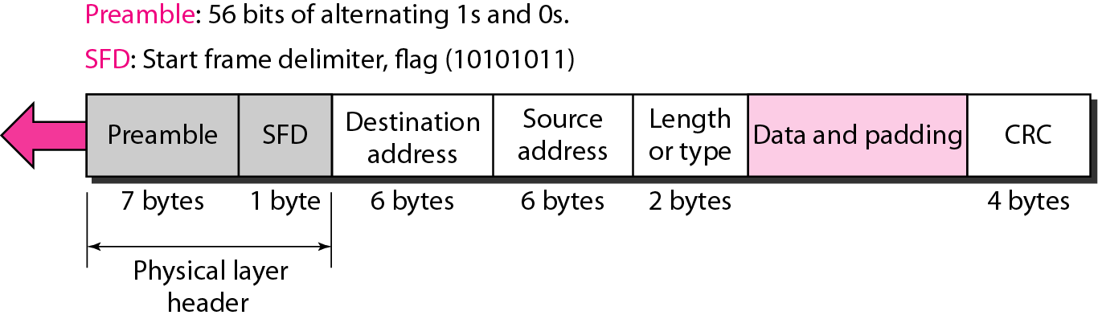
Figure 13.4 802.3 MAC frame

Slide 3
Header
Preamble / SFD: - this element within the header is added by the layer 1 part of the protocol stack. It enables the receiver to synchronise and know that a data frame is about to be sent.
Preamble (PRE) - This is seven bytes long and it consists of a pattern of alternating ones and zeros, and this informs the receiving stations that a frame is starting as well as enabling synchronisation.

Slide 4
Start of Frame Delimiter (SFD) - This consists of one byte and contains an alternating pattern of ones and zeros but ending in two ones.
Destination Address (DA) - This field contains the address of station for which the data is intended, this can be an individual address or multiple addresses as indicated by the destination address field.

Slide 5
Source Address (SA) - The source address consists of six bytes, and it is used to identify the sending station. This is always a single address and this is indicated within the address field. Again the MAC address is used. More details are given in the section below.
Length / Type - This field is two bytes in length. It provides MAC information and indicates the number of client data types that are contained in the data field of the frame. It may also indicate the frame ID type if the frame is assembled using an optional format.(IEEE 802.3 only).

Slide 6
Payload
Data - This block contains the payload data and it may be up to 1500 bytes long. If the length of the field is less than 46 bytes, then padding data is added to bring its length up to the required minimum of 46 bytes.
Later implementations allowed for so-called ‘jumbo’ frames up to 9,000 bytes long to facilitate certain types of large traffic flows such as file transfers and video links.

Slide 7
Trailer
Frame Check Sequence (FCS) - This field is four bytes long. It contains a 32 bit Cyclic Redundancy Check (CRC) which is generated over the DA, SA, Length / Type and Data fields.
After the Ethernet data frame itself there is an inter-frame gap of a minimum of 12 bytes of data. This acts as a delimiter to ensure that the receiver knows the frame is complete before any further data is sent.

Slide 8
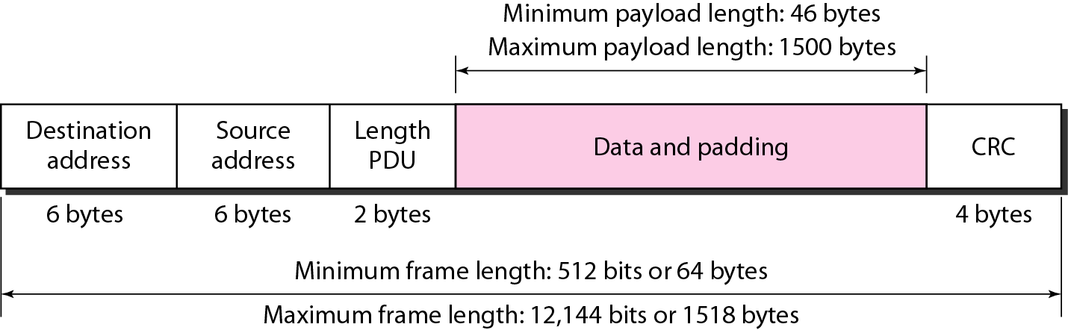
Figure 13.5 Minimum and maximum lengths

Slide 9
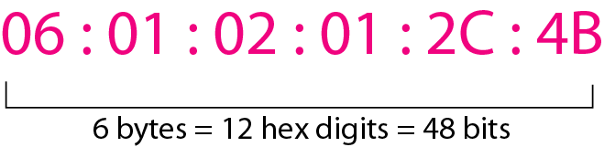
Figure 13.6 Example of an Ethernet address in hexadecimal notation

Slide 10
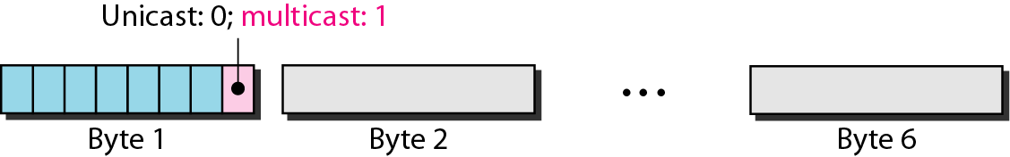
Figure 13.7 Unicast and multicast addresses

Slide 11

Note
The least significant bit of the first byte defines the type of address. If the bit is 0, the address is unicast; otherwise, it is multicast.

Slide 12
Note
The broadcast destination address is a special case of the multicast address in which all bits are 1s.

Slide 13
Example 13.1
Define the type of the following destination addresses:
a. 4A:30:10:21:10:1A b. 47:20:1B:2E:08:EE
c. FF:FF:FF:FF:FF:FF
Solution
To find the type of the address, we need to look at the second hexadecimal digit from the left.
If it is even, the address is unicast.
If it is odd, the address is multicast.
If all digits are F’s, the address is broadcast. Therefore, we have the following:
a. This is a unicast address because A in binary is 1010.
b. This is a multicast address because 7 in binary is 0111.
c. This is a broadcast address because all digits are F’s.

Slide 14
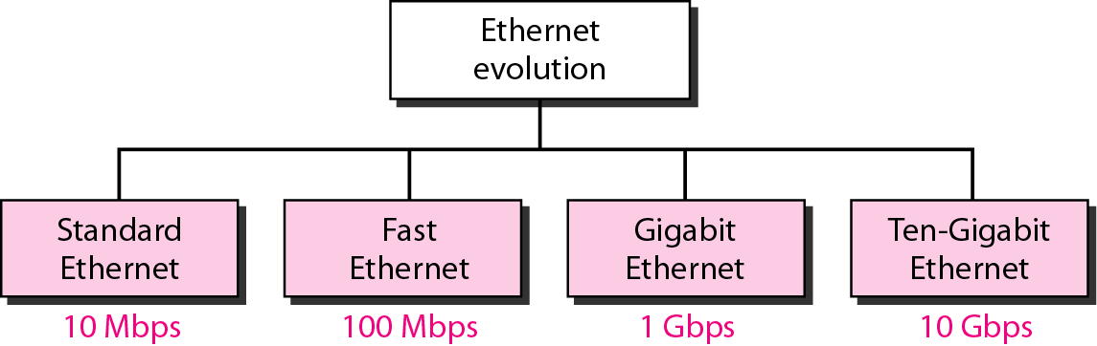
Figure 13.3 Ethernet evolution through four generations

Slide 15
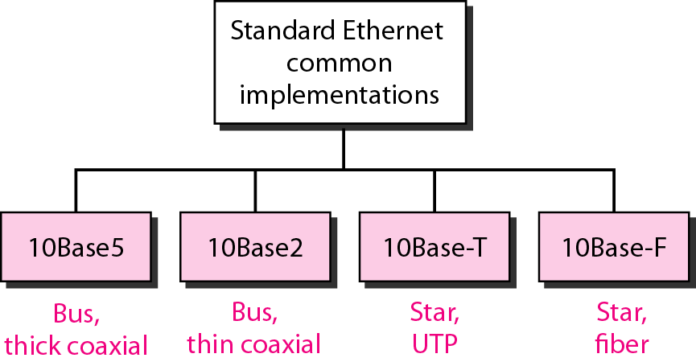
Figure 13.8 Categories of Standard Ethernet

Slide 16
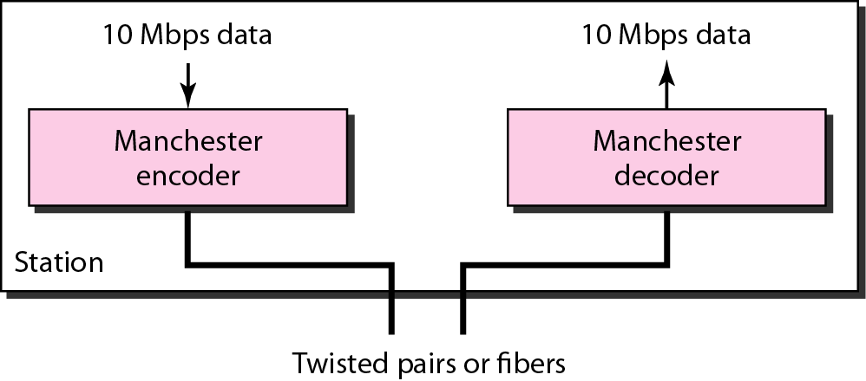
Figure 13.9 Encoding in a Standard Ethernet implementation

Slide 17
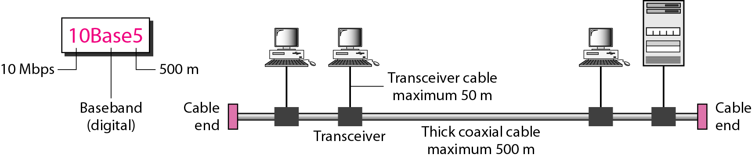
Figure 13.10 10Base5 implementation

Slide 18
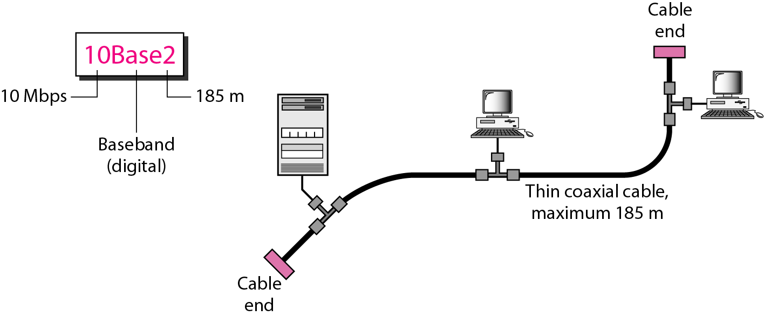
Figure 13.11 10Base2 implementation

Slide 19
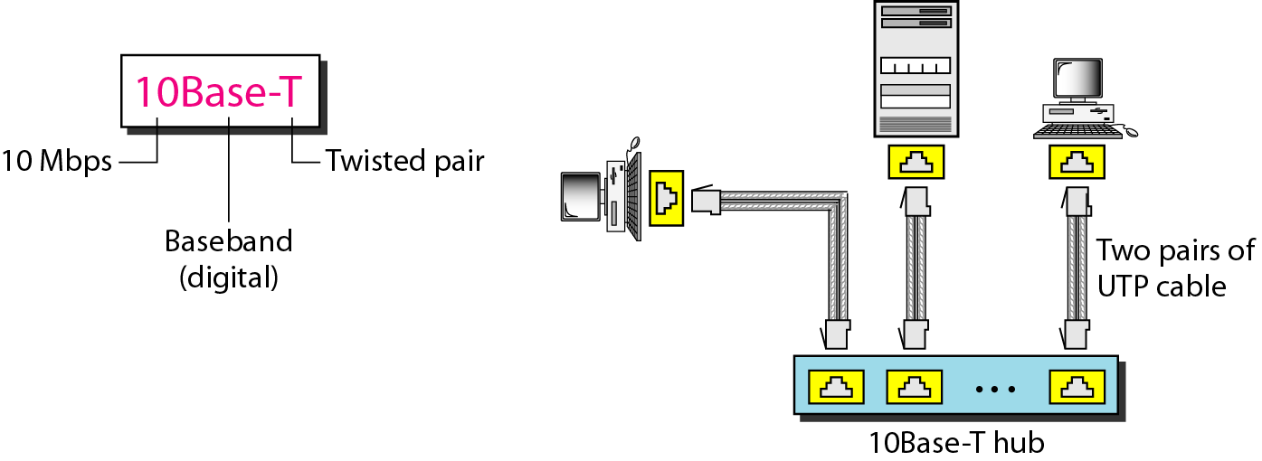
Figure 13.12 10Base-T implementation

Slide 20
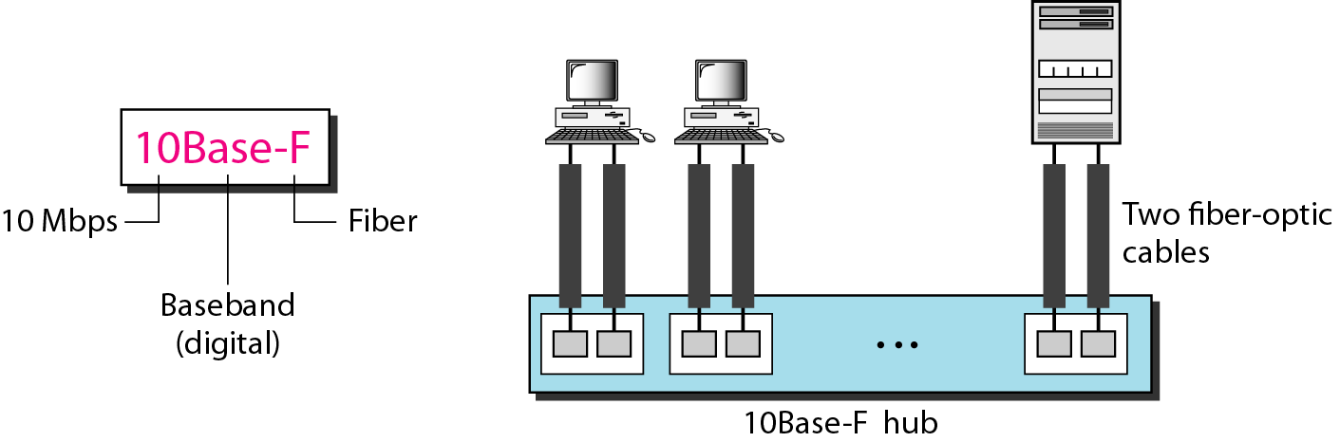
Figure 13.13 10Base-F implementation

Slide 21
Table 13.1 Summary of Standard Ethernet implementations

Slide 22
Standardization of Wireless Networks
Wireless networks are standardized by IEEE.
Under 802 LAN MAN standards committee.
Application
Presentation
ISO
OSI
7-layer
model
Session
IEEE 802
standards
Transport
Network
Logical Link Control
Data Link
Medium Access (MAC)
Physical
Physical (PHY)
Notes:
Same organization that came up with IEEE 802.3 Ethernet,
which is responsible for success of Internet

Slide 23
IEEE 802.11 Overview
Adopted in 1997.
Defines;
MAC sublayer
MAC management protocols and services
Physical (PHY) layers
IR
FHSS
DSSS
Goals
To deliver services in wired networks
To achieve high throughput
To achieve highly reliable data delivery
To achieve continuous network connection.

Slide 24
Components
Station
BSS - Basic Service Set
IBSS : Infrastructure BSS : QBSS
ESS - Extended Service Set
A set of infrastrucute BSSs.
Connection of APs
Tracking of mobility
DS – Distribution System
AP communicates with another

Slide 25
Services
Station services:
authentication,
de-authentication,
privacy,
delivery of data
Distribution Services ( A thin layer between MAC and LLC sublayer)
association
disassociation
reassociation
distribution
Integration
A station maintain two variables:
authentication state (=> 1)
association state (<= 1)

Slide 26
Medium Access Control
Functionality;
Reliable data delivery
Fairly control access
Protection of data
Deals;
Noisy and unreliable medium
Frame exchange protocol - ACK
Overhead to IEEE 802.3 -
Hidden Node Problem – RTS/CTS
Participation of all stations
Reaction to every frame

Slide 27
MAC
Retry Counters
Short retry counter
Long retry counter
Lifetime timer
Basic Access Mechanism
CSMA/CA
Binary exponential back-off
NAV – Network Allocation Vector
Timing Intervals: SIFS, Slot Time, PIFS, DIFS, EIFS
DCF Operation
PCF Operation

Slide 28
PCF Operation
Poll – eliminates contention
PC – Point Coordinator
Polling List
Over DCF
PIFS
CFP – Contention Free Period
Alternate with DCF
Periodic Beacon – contains length of CFP
CF-Poll – Contention Free Poll
NAV prevents during CFP
CF-End – resets NAV

Slide 29
Frame Types
NAV information
Or
Short Id for PS-Poll
Upper layer data
2048 byte max
256 upper layer header
FC
Duration
/ID
Address
1
Address
2
Address
3
Sequence
Control
Address
4
DATA
FCS
2 2 6 6 6 2 6 0-2312 4 bytes
Protocol Version
Frame Type and Sub Type
To DS and From DS
More Fragments
Retry
Power Management
More Data
WEP
Order
IEEE 48 bit address
Individual/Group
Universal/Local
46 bit address
MSDU
Sequence Number
Fragment Number
CCIT CRC-32 Polynomial
BSSID –BSS Identifier
TA - Transmitter
RA - Receiver
SA - Source
DA - Destination

Slide 30
Frame Subtypes
CONTROL
DATA
MANAGEMENT
RTS
CTS
ACK
PS-Poll
CF-End & CF-End ACK
Data
Data+CF-ACK
Data+CF-Poll
Data+CF-ACK+CF-Poll
Null Function
CF-ACK (nodata)
CF-Poll (nodata)
CF-ACK+CF+Poll
Beacon
Probe Request & Response
Authentication
Deauthentication
Association Request & Response
Reassociation Request & Response
Disassociation
Announcement Traffic Indication Message (ATIM)

